Slide 1
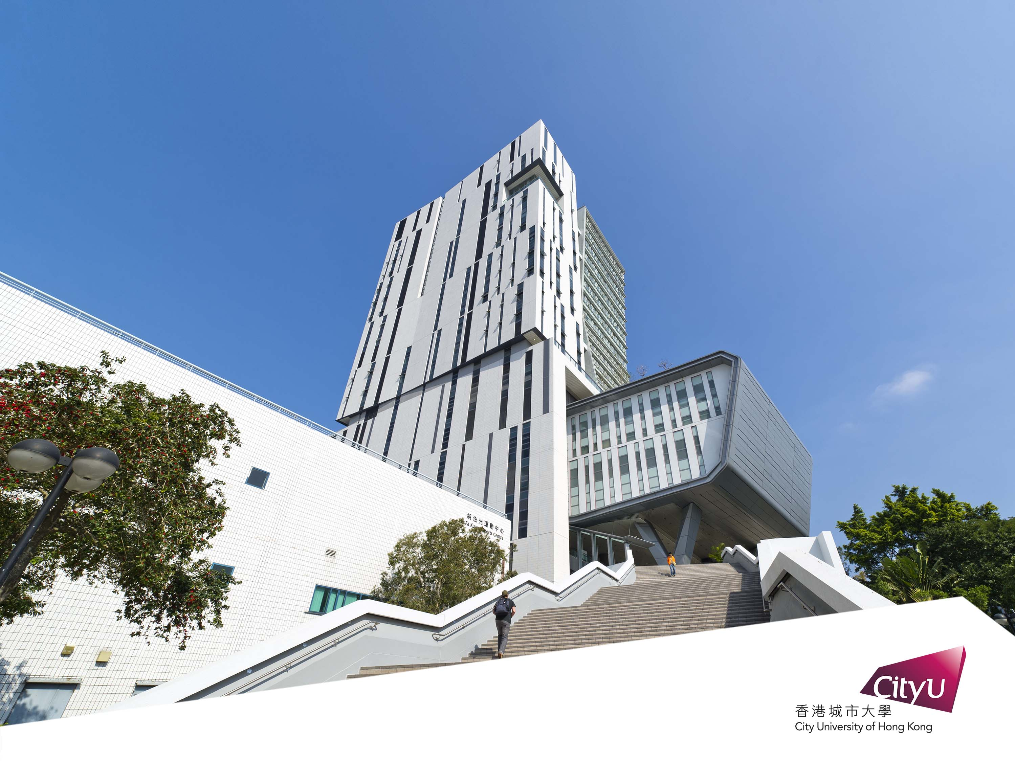

Deep Learning Workshop for EE Principal Nomination Scheme
By CityU EE Department
Dr. Ray Cheung

Slide 2

Building a Pokemon classifier with
TensorFlow, Keras and Colab

Slide 3
Outline
Basic Concept
Hands-on coding
QA Session with the inputs from each of you
Coding optimization
Student sharing – Noel

Slide 4




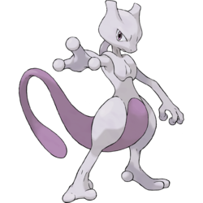
5 types of Pokemon to be classified
比卡超
Pikachu
小火龍
Charmander
車厘龜
Squirtle
奇異種子
Bulbasaur
超夢夢
Mewtwo

Slide 5
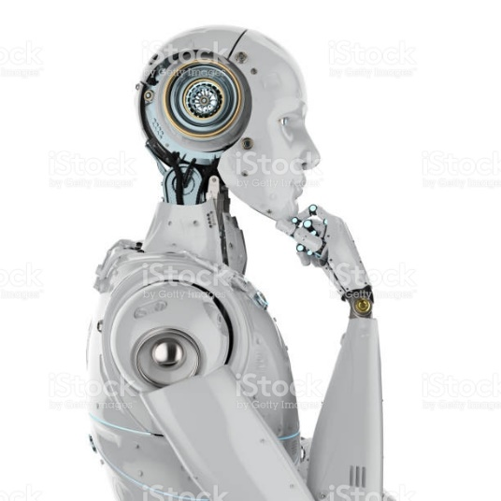
Which class does this image belong to?
Pikachu
Charmander
Squirtle
Bulbasaur
Mewtwo
Input image
Machine learning classifier

Slide 6
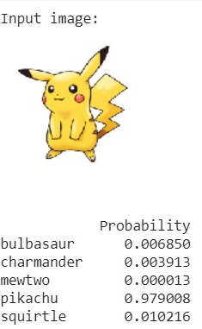
Which class does this image belong to?
Input image
Machine learning classifier

Slide 7
AI, Machine Learning, Deep Learning
Intelligence: an ability to perceive or infer information, to retain it as a knowledge
Artificial Intelligence: emulate Human Behaviors
Machine learning: math. model with a lot of data
Deep Learning: using multi-layer neural network computations
e.g. Identify Pokémon images

Slide 8
TensorFlow, Keras and Colab
TensorFlow
Open Source Machine Learning library
Keras
High Level API
Colaboratory(Colab)
Free Jupyter notebook environment with free GPU runtime
CPU: Bicycle
GPU: Car
TPU: Rocket
Open Keras
Google TensorFlow
Microsoft CNTK

Slide 9
TensorFlow, Keras and Colab
Data collection
Defining your model
Model training
Model evaluation
Prediction
most of the work
few lines of code
one line
one line
one line

Slide 10
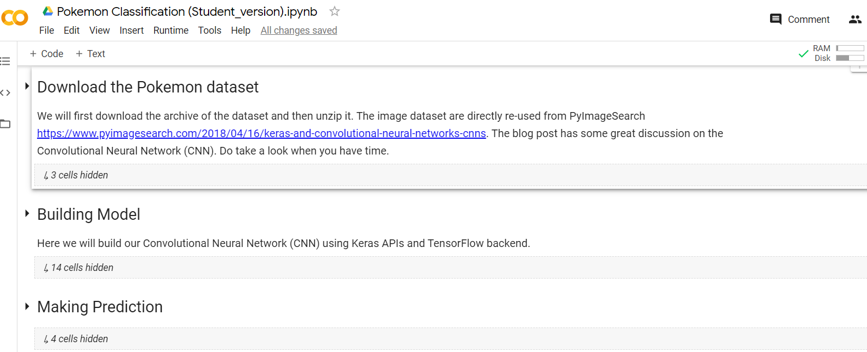
Coding Environment
Example notebook: http://bit.ly/pokemon_classification

Slide 11
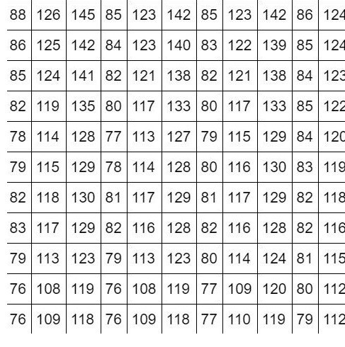
How do computers “see”?
What your computer see
What you see

Slide 12

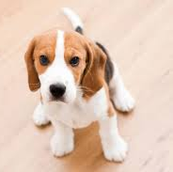
Extracting features from images
We look for lines, edges and shapes to learn the concept of a dog
These are the features we want to extract
Lines, Edges, Shapes (features)
Image
Concept of a dog

Slide 13
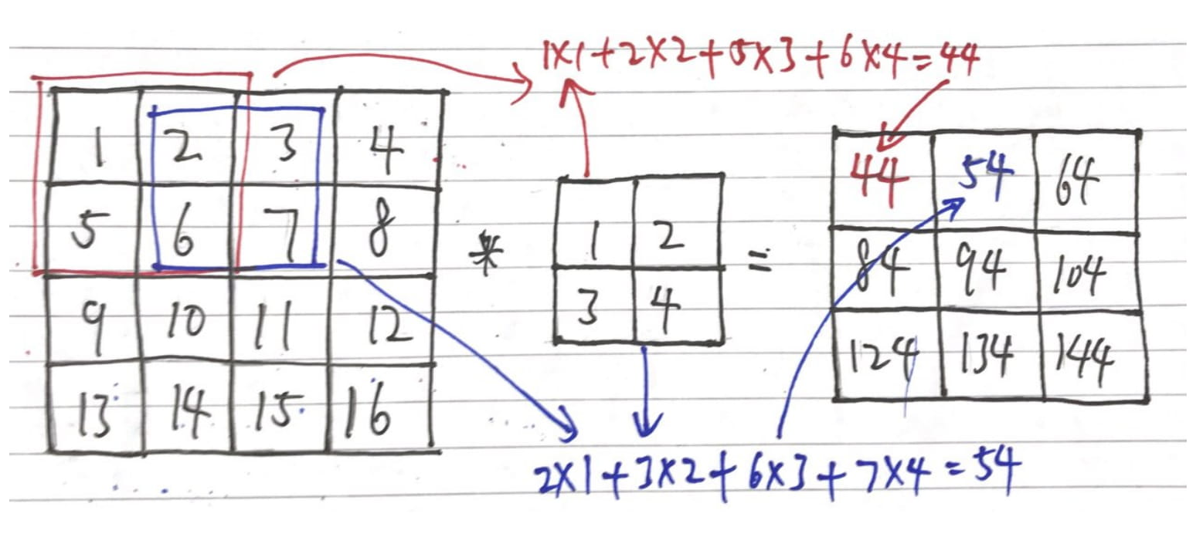
Convolution – detecting edges from images
The math operation “convolution” can be used to detect edges/extract features from an image
Image
Feature map
Filter/kernel

Slide 14
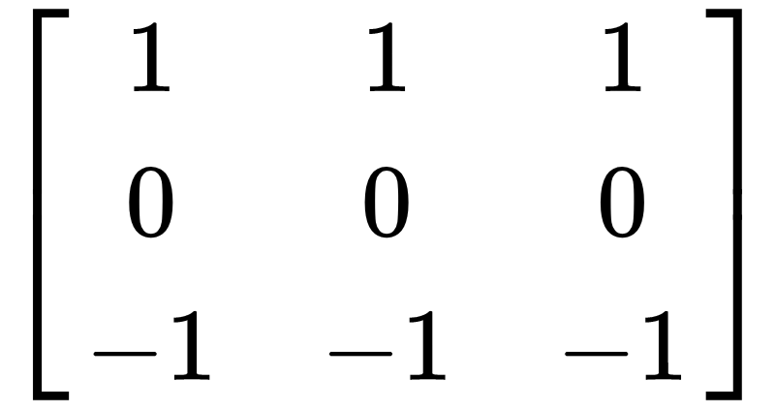
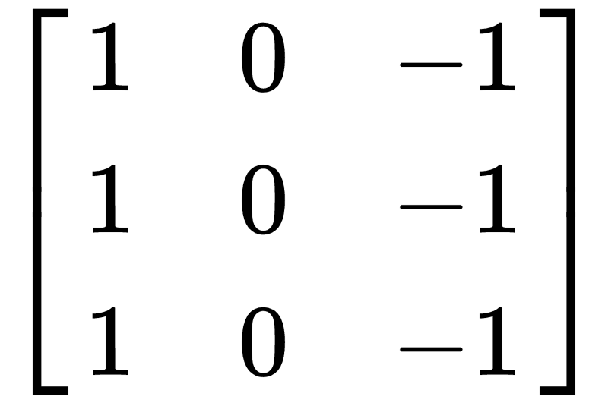
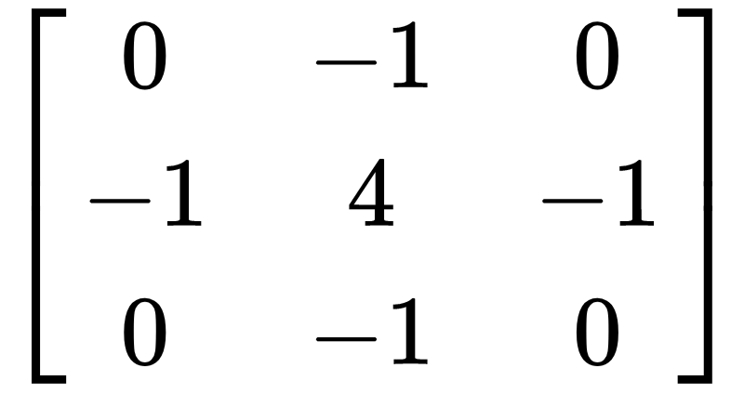
Convolution – detecting edges from images
These filters can be used to detect horizontal lines, vertical lines, and edges respectively
Horizontal line filter
Vertical line filter
Laplacian filter (edge detection)

Slide 15
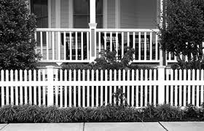
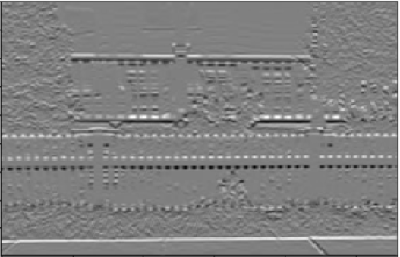
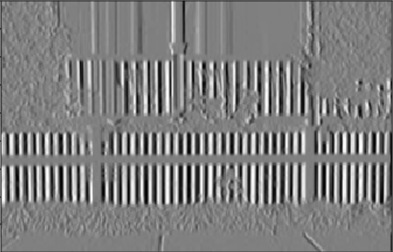
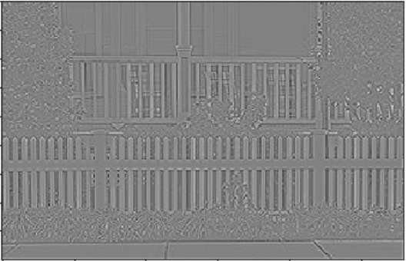
Convolution – detecting edges from images
An image after taking the convolution with…
Horizontal line filter
Laplacian filter (edge detection)
Vertical line filter

Slide 16
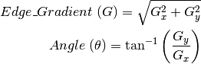
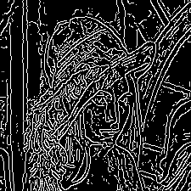
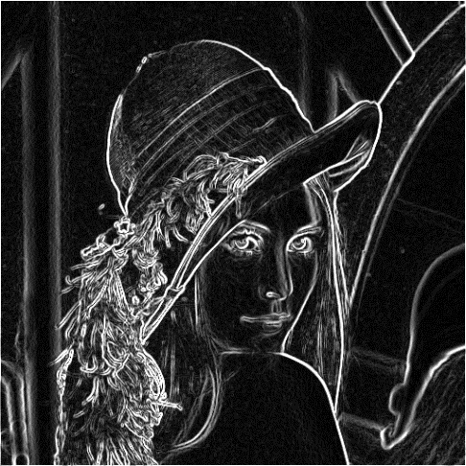

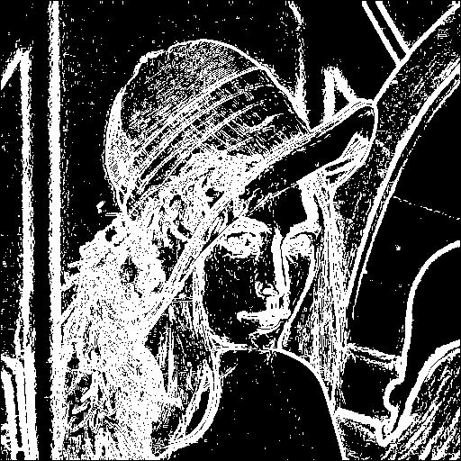
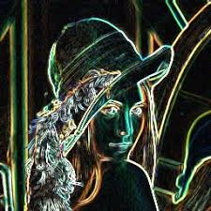
Image Processing – Lena Sobel
All about Mathematics

Slide 17
Now I have the features,
what’s next?

Slide 18

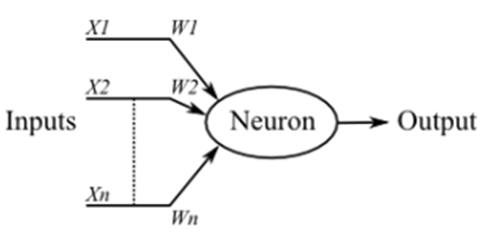
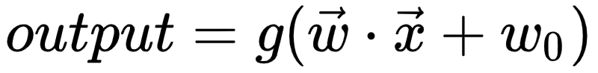
Modelling the brain – artificial neural network
A biological neuron

Slide 19
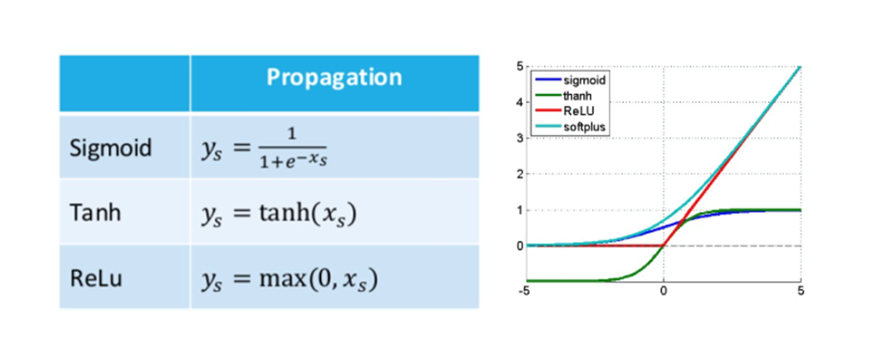
Activation Function ━ Adding Non-Linearity
Full list of common activation functions: https://keras.io/activations/

Slide 20
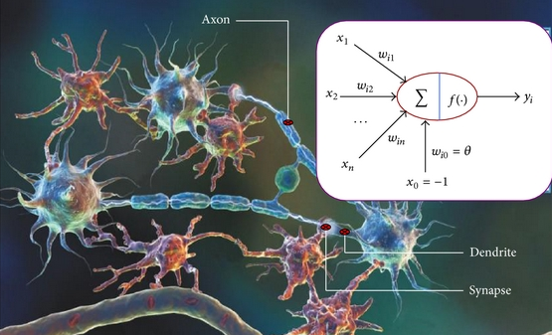
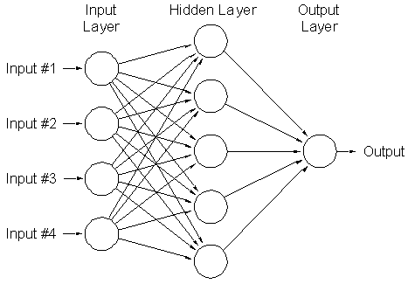
Modelling the brain – artificial neural network
Putting many neurons together, we have an artificial neural network
Aka: deep neural network, fully connected neural network, connectionist system, multilayer perceptron etc

Slide 21
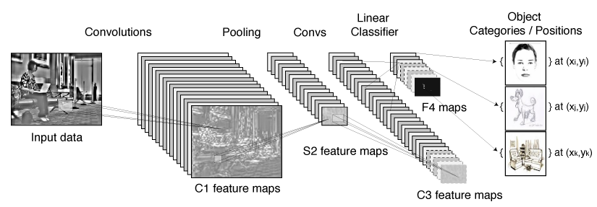
Learning the filters by convolutional neural network
Instead of handcrafting the filters, they can be learned by the convolutional neural network
Fully connected layer
Class probability
90%
5%
Feature map
5%
Feature map
Feature map

Slide 22
General Advice
Solid Mathematics
Foundation in High School
Moderate Coding skills
Identify you AI Model and Application Domain
Create an active learning circle with the help from school teachers & parents

Slide 23
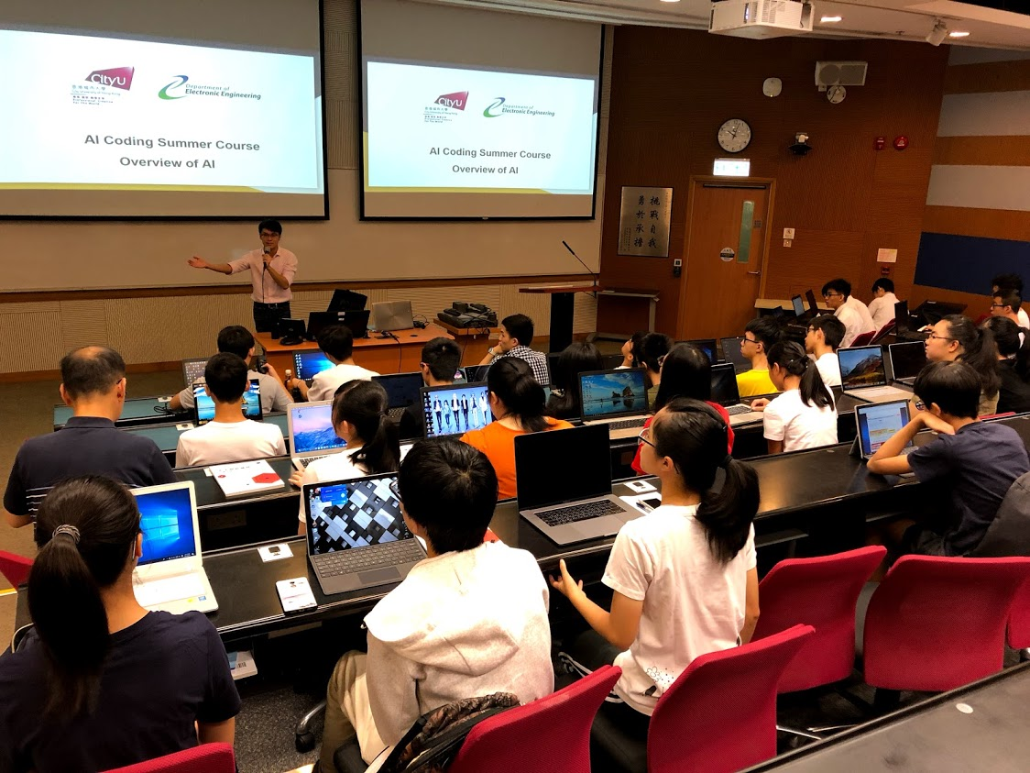
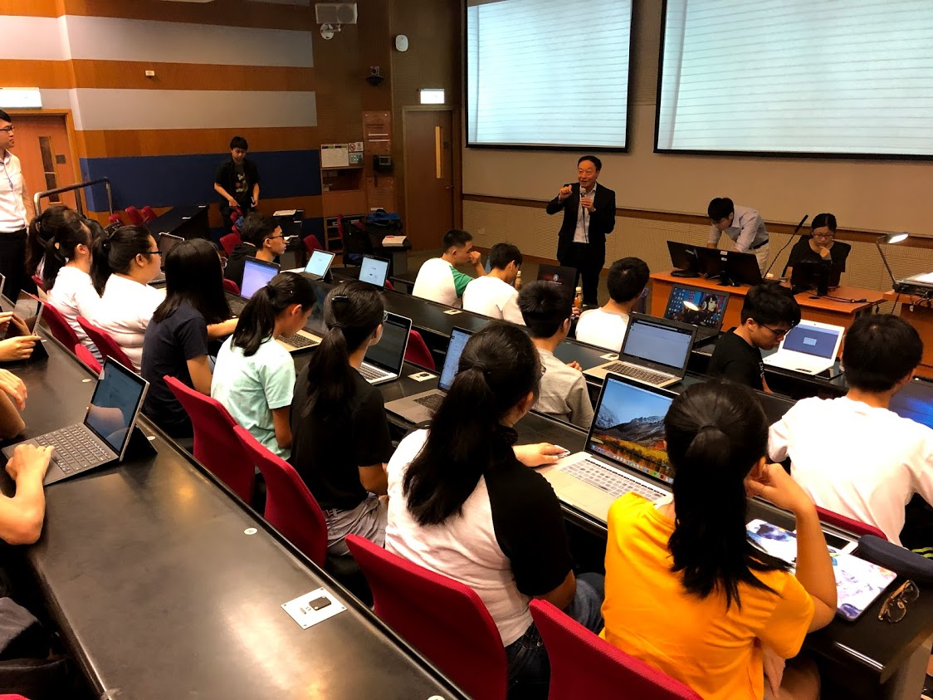
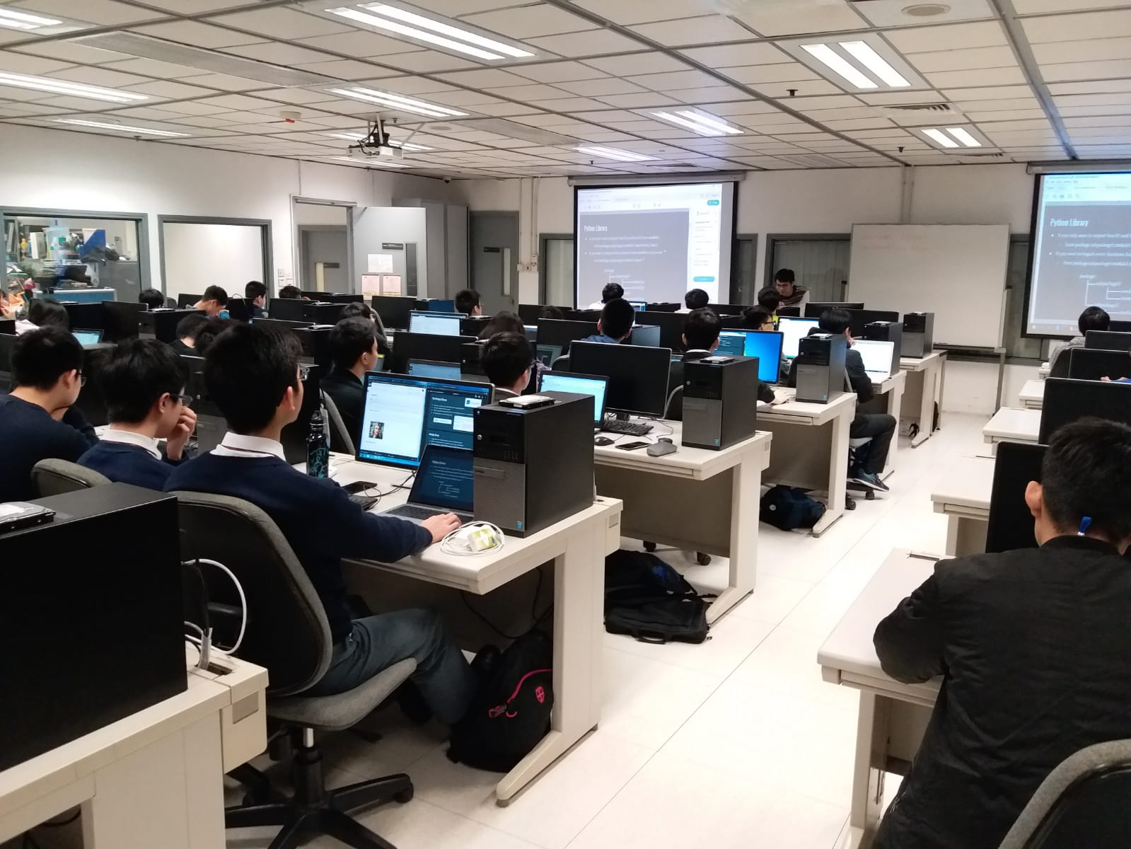
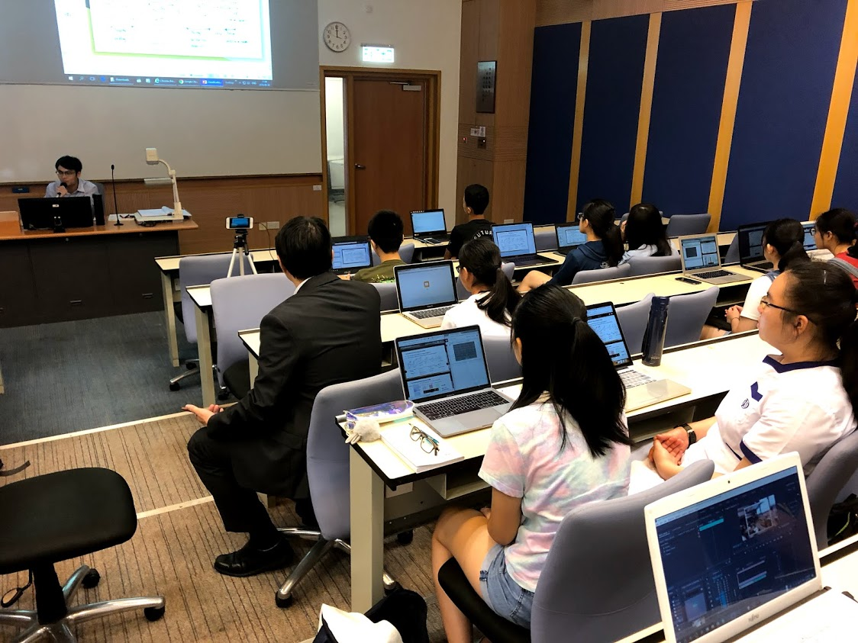
Past workshops

Slide 24
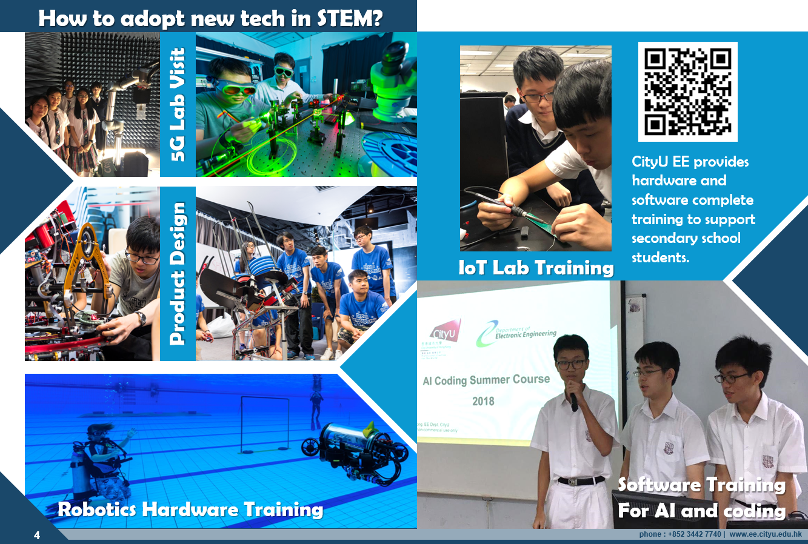

Slide 25

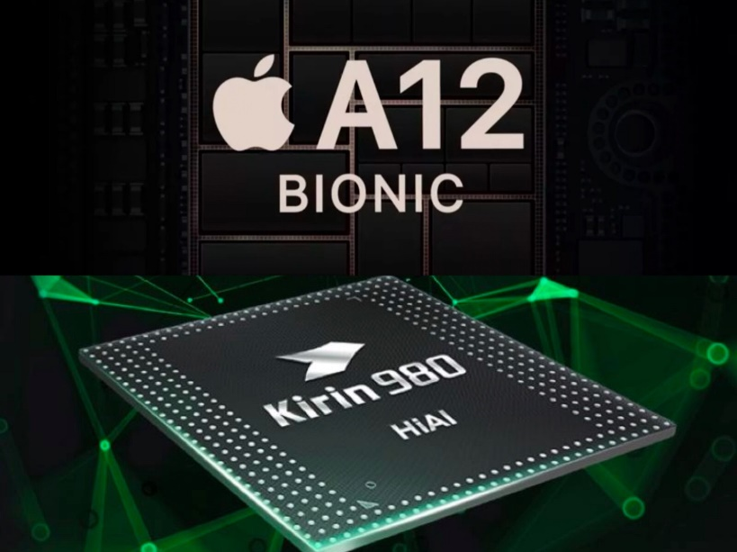
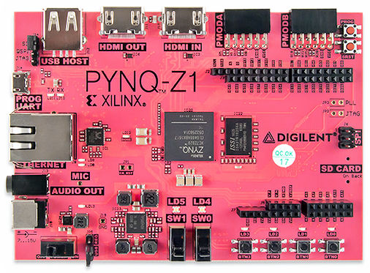

Slide 26
Hands-on coding!
We will share the details over this weekend.

Slide 27

What’s Next?
1) Principal Nomination Scheme
2) AI Workshop for High School Students
3) EE International students summer course
4) Face Recognition workshop for High School Students
5) Others upcoming
https://www.ee.cityu.edu.hk/home/

Slide 28

https://www.ee.cityu.edu.hk/home/doc/programme/CityU_EE-V3.0.pdf

Slide 29
Acknowledgements
Prof. Stella Pang – Head, Department of EE
Kinni Mew – CityU EE Alumni, GDG Developer
John Wong – Research Assistant, Department of EE
Credit to PyImageSearch for the dataset
(https://www.pyimagesearch.com/2018/04/09/how-to-quickly-build-a-deep-learning-image-dataset/)

Slide 30


